Slide 1
More Drinking, More Deaths?
Investigating the Relationship Between State Alcohol Consumption and Drunk Driving Fatalities
Xina Wang
Jan. 30, 2026

Slide 2
Drunk Driving
Drunk driving occurs when a person operates a vehicle while alcohol-impaired, defined as a blood alcohol concentration (BAC) of 0.08 g/dL or higher [1].
Alcohol-impaired driving leads to fatal motor vehicle crashes, resulting in the deaths of drivers, passengers, and innocent bystanders such as pedestrians.
In 2022, 13,524 people were killed in crashes involving alcohol-impaired drivers, accounting for 32% of all traffic-related fatalities in the United States [2].
Although alcohol-related traffic fatalities have declined over time, millions of people continue to drive under the influence each year [1,2].
Page #

Slide 3
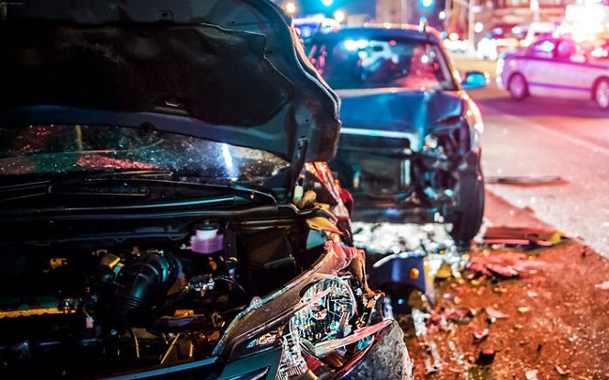
The Question
What factors contribute to drunk driving deaths across U.S. states?
→ Does state-level alcohol consumption predict drunk driving deaths?
Hypothesis: States with higher per capita alcohol consumption will experience higher rates of drunk driving fatalities.
Page #

Slide 4
Datasets
Fatal Crash Data (2022) from the National Highway Traffic Safety Administration (NHTSA)
Had data on persons killed in a crash and the driver’s BAC level by state
Challenge: this dataset only has the raw death count, not death per capita (raw numbers are not a good metric; some states are less/more populated than others and will naturally have less/more people being killed by traffic accidents).
State Population Data (2022) from the US Census Bureau
Added to normalize data across states of different sizes and calculate deaths per 100K population for fair comparison.
Alcohol Consumption by State (2022) from National Institute on Alcohol Abuse and Alcoholism (NIAAA)
Had data on per capita ethanol consumption by state, breakdown by beverage type (beer, wine, spirits), and includes consumption deciles (state rankings)
Additional questions I now wanted to explore from these datasets:
Does alcohol type matter (beer vs. wine vs. spirits)?
What insights can we gain from comparing high-alcohol consumption states (decile 1) vs. low-consumption states (decile 10)?
Page #

Slide 5
Data Cleaning & Processing
Key Variables:
Granularity: State-level (51 observations: 50 states + DC)
Independent variable: Total alcohol consumption per capita (gallons of ethanol)
Dependent variable: Alcohol-related deaths per 100K population
Challenges & Solutions:
NIAAA Alcohol Consumption Data: PDF table wouldn't download from website link
Solution: Extracted table from PDF using pdfplumber library, wrote custom regex patterns to parse table structure correctly → Output: alcohol_consumption_2022.csv
NHTSA Traffic Fatality Data: raw data in text format, not standard CSV
Solution: Read as tab-delimited CSV file → Output: blood_alcohol_data_and_deaths.csv
Merging Datasets: inconsistent state naming (e.g., "District of Columbia" vs. "Dist. of Columb.")
Solution: Standardized all state names before merging → Output: merged_alcohol_deaths.csv
Page #

Slide 6
Data Cleaning & Processing
Key Variables:
Granularity: State-level (51 observations: 50 states + DC)
Independent variable: Total alcohol consumption per capita (gallons of ethanol)
Dependent variable: Alcohol-related deaths per 100K population
Final Population Normalization:
Extracted POPEST2022 column from Census data
Filtered to include only states (excluded regional aggregates)
Merged data into current dataset and calculated deaths per 100K population for each BAC level
Although we only need BAC 0.08+ data for this study, calculating the total deaths per 100K population and for the other BAC levels was to validate that they sum together properly
→ Final dataset: final_alcohol_analysis.csv (ready for analysis)
Page #

Slide 7
Analysis Script
Correlation analysis between alcohol consumption and drunk driving deaths (focusing on BAC ≥ 0.08, the legal limit)
Linear regression with scatter plot visualization
Comparison of high-consumption states (top 30%) vs. low-consumption states (bottom 30%)
Alcohol type analysis: calculates separate correlations for beer, wine, and spirits
Outlier identification to find states that don't fit the expected pattern
Key things I’m looking for:
Is there a positive correlation between alcohol consumption and drunk driving deaths?
Is the relationship statistically significant (R² and correlation strength)?
Which states are outliers and why might they deviate from the pattern?
Does the type of alcohol consumed matter (beer vs. wine vs. spirits)?
Do high-drinking states have significantly more drunk driving deaths than low-drinking states?
Page #

Slide 8
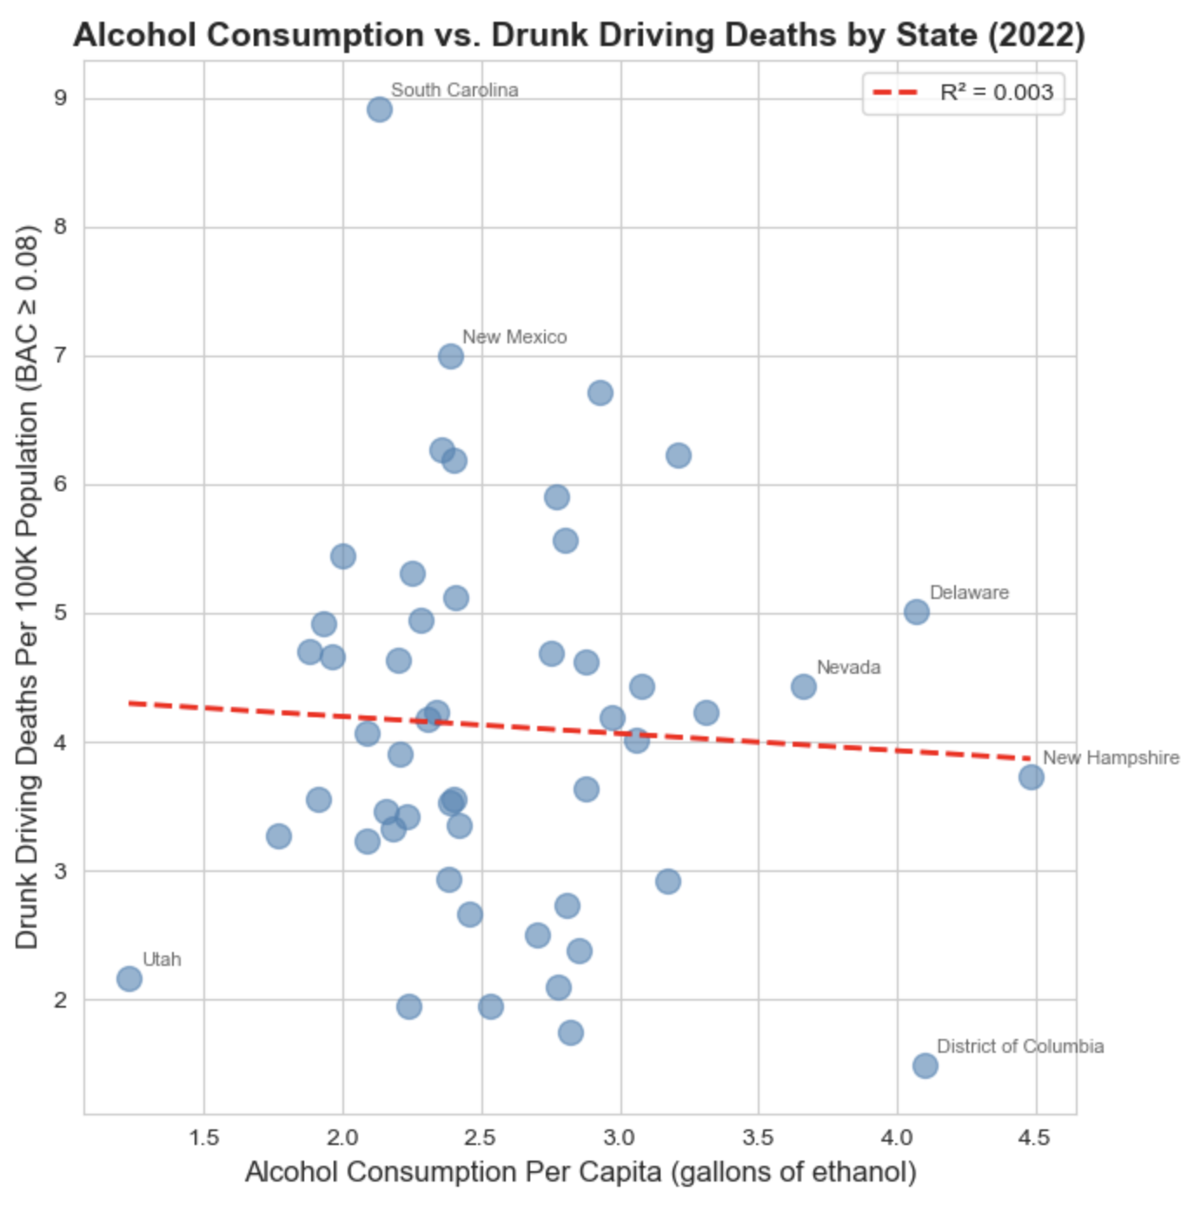
Results- Scatterplot
Key Statistics:
Correlation: -0.054 (essentially zero)
R² = 0.003 (only 0.3% of variation explained)
Regression line is nearly flat
Conclusion: There is NO meaningful relationship between state alcohol consumption and drunk driving deaths.
How much a state drinks does NOT predict its drunk driving death rate!
Page #

Slide 9
Results- Outliers
States that defy the expected pattern:
South Carolina: 2.13 consumption → 8.9 deaths per 100K (HIGHEST)
Below-average drinking, but highest fatality rate
New Hampshire: 4.48 consumption → 3.7 deaths per 100K
Highest drinking state, but moderate death rate
District of Columbia: 4.10 consumption → 1.49 deaths per 100K (LOWEST)
Second-highest drinking, but lowest fatality rate
→ The states that drink the MOST have among the FEWEST drunk driving deaths? Let’s confirm.
Page #

Slide 10
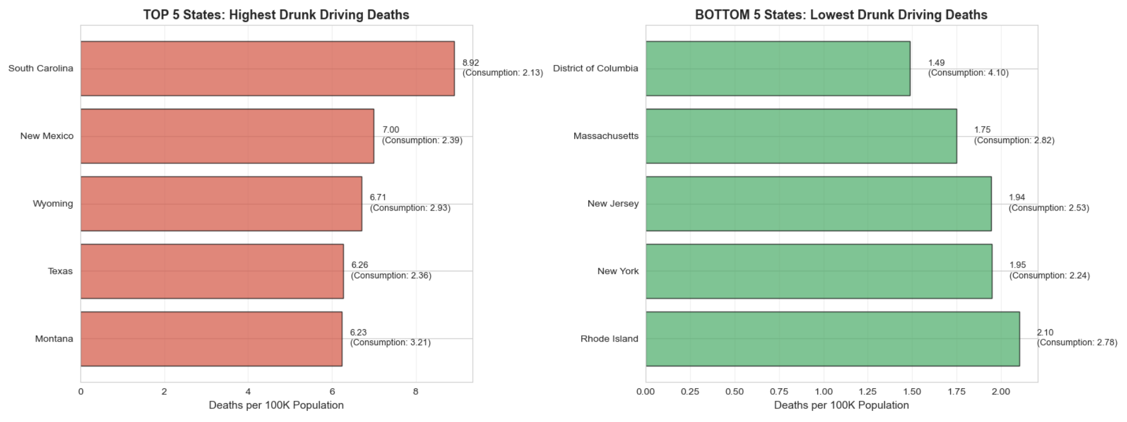
Results- Top vs. Bottom States
Page #

Slide 11
The Paradox:
Highest deaths: South Carolina (consumption: 2.13) and New Mexico (2.39) drink BELOW average
Lowest deaths: DC (4.10) and Massachusetts (2.82) drink ABOVE average
States that consume more alcohol do NOT have more drunk driving deaths. In fact, high-consumption states tend to have LOWER death rates.
Page #

Slide 12
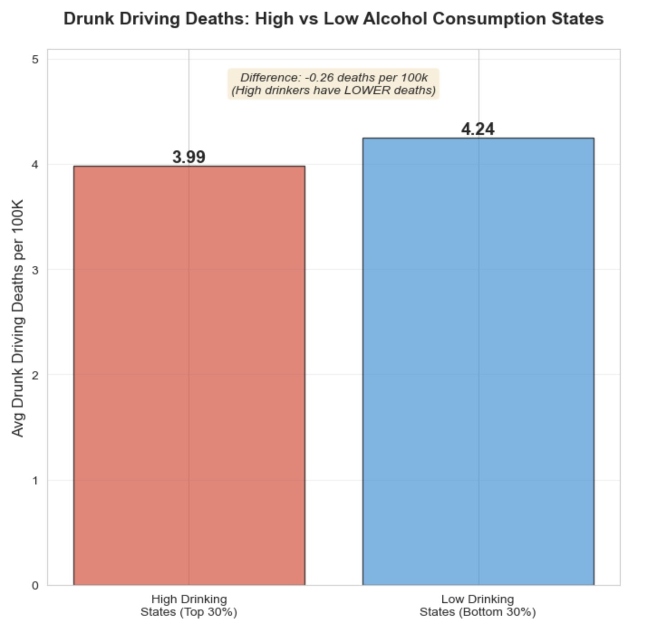
Results- High vs. Low Consumption
High drinking states (top 30%) average deaths per 100K: 3.99
Low drinking states (bottom 30%) average deaths per 100K: 4.24
The difference is negligible (0.26), confirming there's no meaningful relationship between state alcohol consumption levels and average state drunk-driving deaths.
High-drinking states even have slightly FEWER average deaths.
Page #

Slide 13
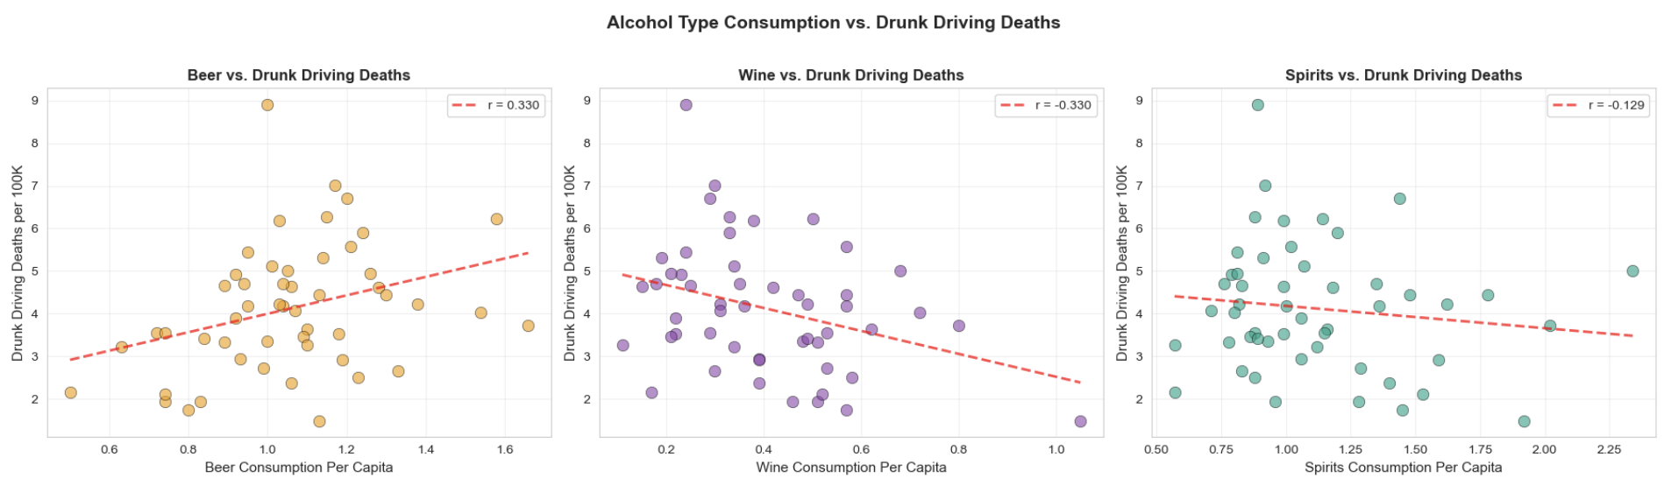
Results- Alcohol Types
Beer shows slight positive correlation (0.3300) with deaths
Wine shows slight negative correlation (-0.3299) with deaths
Spirits shows very slight negative correlation (-0.1295) with deaths
Beer is the ONLY alcohol type with a positive relationship to drunk driving deaths, while wine and spirits show the opposite pattern. All correlations remain weak overall.
Page #

Slide 14
Discussion
Urban vs. Rural
DC, NY, NJ, MA (low deaths) are dense urban areas with public transit. Wyoming, Montana, New Mexico (high deaths) are rural with long driving distances in between towns.
Why do we observe that how much people drink isn’t what determines drunk driving deaths? Other factors likely matter more:
Drinking Culture
Where/how people drink is important (bars vs. at home, if these are within walking distance). Our results for the different alcohol types might suggest that beer drinking culture is associated more with driving and consumed in settings that require more driving (bars in car-dependent areas), while wine drinking is more associated with fine dining and urban settings with alternative transportation.
Page #

Slide 15
Discussion
DUI Enforcement
Some states may be more strictly enforcing DUI’s, not allowing repeat alcohol-impaired drivers back on the road.
Why do we observe that how much people drink isn’t what determines drunk driving deaths? Other factors likely matter more:
Road Infrastructure
Highway design, speed limits
Demographics
Gender, age distribution, tourism, etc. in different states
Page #

Slide 16

1.
2.
3.
4.
Public Transit Analysis
Analyze public transit availability and walkability scores in high vs. low fatality states to quantify the urban/rural effect in certain regions.
Time-Series Analysis Compare drunk driving fatality trends 2005-2025 to assess impact of the popularization of rideshare services (Uber/Lyft/Waymo) on deaths.
DUI Policy Analysis
Compare DUI laws, enforcement practices, and penalties across states to identify which policies are most effective.
Demographic Analysis
Statistical analysis of age and gender to
identify high-risk populations and
geographic hotspots.
Future Directions
Page #

Slide 17
Background Information
Datasets (Linked)
[1] Background on: Alcohol-impaired driving (Insurance Information Institute)
[2] Impaired Driving Facts (CDC)
NIAAA: APPARENT PER CAPITA ALCOHOL CONSUMPTION: NATIONAL, STATE, AND REGIONAL TRENDS, 1977–2022
NHTSA: Persons Killed, by STATE and Highest Driver Blood Alcohol Concentration (BAC) in Crash - State : USA, Year : 2022
2022 US Census Bureau Census: State
This project was inspired by 538 Data’s article “Dear Mona, Which State Has the Worst Drivers?”
References
Page #

